Slide 1
HIDDEN DESCRIPTION SLIDE — NOT TO BE SHOWN TO THE PUBLIC
Staying on Track
Catalogue code: B09
Full presentation or module? Presentation
Slide numbers: B09-1 to B09-39
Registered/Non-Registered Usage: All (Usage limited. See notes below.) (Choices: registered rep use only, not for registered rep use, allowed for all, partial limitations)
Last update info: Date updated: 2015-11-05
Project #27007 Description of changes: updated home page on slide B09-21
Filed with FINRA? No If yes, date:
Notes: This can be used by all reps but is limited to use with church plans (403(b)9)) only. It may not be used for promoting other plans such as retail, 401(k) and 403(b)(7).

Slide 2
Staying on Track:
What type of investor are you?
B09-1
Notes:
I don’t need to tell you that the financial markets had more than their share of troubles in 2008 and 2009.
Almost all types of investments were impacted in a negative way.
In regard to the U.S. stock market, we have just come through the first decade since the Great Depression where stocks had negative returns over a 10-year period of time.
As a result, many of us saw our retirement account balances drop by up to 30–50%, depending upon how we were invested. Fortunately things seem to be stabilizing some.
So — what did we learn from this recent financial and investment crisis? Will we do anything differently now when it comes to investing for our retirement than we were doing before the downturn?

Slide 3
What type of investor are you?
STAYING ON TRACK
Accidental or Intentional?
Small Picture or Big Picture?
Disconnected or Connected?
B09-2
Notes:
In our time together today, I want to challenge you to think about what type of investor you were before the financial crisis — and what type of investor should you be now, following the crisis?
To do this, I want to ask you three simple questions that will help you see what type of investor you may have been — and what type of investor you may need to be in the future.
Are you:
An Accidental or Intentional investor?
Do you focus on the Small Picture or Big Picture?
Are you Disconnected or Connected to your finances?
Let’s take a closer look at how to determine what type of investor you are.

Slide 4
Accidental or Intentional?
STAYING ON TRACK
Accidental
Started investing for retirement because your employer put you in their plan
Don’t really understand the plan or how it works
Not really sure how much you are investing
B09-3
Notes:
Here’s our first simple question: Are you an Accidental or Intentional investor?
Here are some of the signs of an Accidental investor:
You started investing for retirement because your employer put you into their plan. It’s not something you really decided or thought about — it just happened.
And now that you’re in that plan, you’re not really sure what it is or how it works. All you know is that it is a “401 or 403 or 40 something”!
And if you’re an Accidental investor there’s a good chance you’re not even sure how much you are contributing — it’s whatever your employer puts in.

Slide 5
Accidental or Intentional?
STAYING ON TRACK
Intentional
Understand your retirement plan
B09-4
Notes:
Or are you an Intentional investor?
An Intentional investor is making an active effort to find out what they are investing in and how it works. Why? Because they realize that the more they know and understand about the retirement plan they are investing in, the more they will be able to use it to make sure they are financially secure so they can do what they have dreamed about doing when they retire.

Slide 6
Understand Your Retirement Plan
STAYING ON TRACK
403(b)
Tax-sheltered retirement plan
Defined contribution plan
Personal and employer contributions
B09-5
Notes:
The plan you are investing in through your employer is a 403(b)(9) retirement plan available through GuideStone Financial Resources of the Southern Baptist Convention.
403(b) is the tax code designation given to retirement plans of non-profit organizations. This plan is similar to 401(k) plans, which are open to employees of for-profit businesses.
The term “tax-sheltered” means that this plan allows participants to defer the payment of taxes on contributions and investment earnings until they are taken out of the plan at retirement. Some plans allow for Roth elective deferrals, which means you can use after-tax dollars for your contributions — and pay no taxes at retirement for qualified distributions.
You participate in a defined contribution plan. This simply means there is no preset formula in place to determine the size of your income. Income amounts at retirement are defined by the contributions and earnings accumulated in the account. In simple terms, if you invest small amounts in a plan like this, you will have a small income payment at retirement. The larger your contributions and earnings through the years, the larger your income payment will be when you retire.
In this plan, your employer can make contributions. (Describe what their employer does.)
In your retirement plan, you can make contributions too. This can be done on a tax-sheltered basis by completing a Salary Reduction Agreement with your employer and allowing them to deduct money from your regular paycheck on a pretax basis that is then contributed to your retirement account as your participant-paid contribution.
An important note for ministers is that, when you make this type of contribution, it is not only sheltered from income taxes but also Social Security taxes, which can further reduce your annual tax bill by around 15%.

Slide 7
Accidental or Intentional?
STAYING ON TRACK
Intentional
Understand your retirement plan
Estimate your retirement income needs
B09-6
Notes:
An Intentional investor has also made the effort to think about how much income they will need when they retire to be able to do the things they are dreaming about doing in their retirement years.
Whether your retirement dreams are filled with gardening, grandchildren or golf — or the ability to continue to minister and serve in some type of mission setting — if you don’t know how much it will take to accomplish those dreams, there is a good chance those dreams will not become reality.

Slide 8
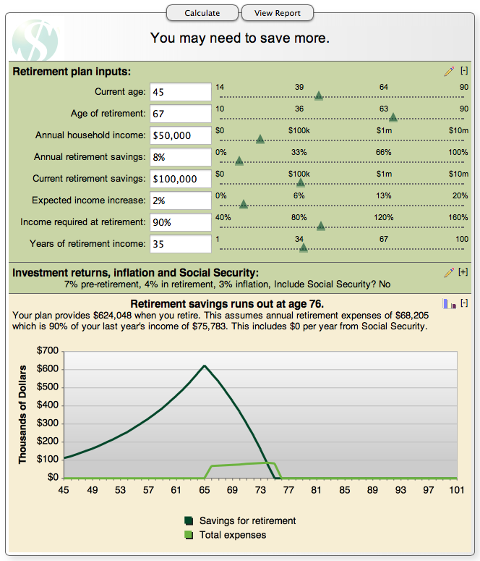
Estimate Your Retirement Income Needs
STAYING ON TRACK
B09-7
Notes:
There are different ways to determine how much you need to be saving for retirement, but one easy way is to go to www.GuideStone.org/calculators and use some of our helpful calculators.
With the Retirement Planner calculator pictured here, you can quickly get an idea of how much you will need when you retire and whether you are on track to have that much retirement income based on your current level of contributions. It will even give you an estimate of how much you can expect from Social Security benefits.

Slide 9
Accidental or Intentional?
STAYING ON TRACK
Intentional
Understand your retirement plan
Estimate your retirement income needs
Take advantage of incentives
B09-8
Notes:
As an Intentional investor, you also want to make sure you are contributing enough to get any and all matching contributions that are available to you.
[Review any available matches from their employer.]
[Remind ChRP participants of State Convention matching contributions or MCAF matching funds from GuideStone that they could be eligible to receive.]
[Remind audience to consider the Tax Saver’s Credit (Form 8880) — IRS credit of up to $2,000 per individual for those who contribute personally (participant contributions).]

Slide 10
Small Picture or Big Picture?
STAYING ON TRACK
Small Picture
I can’t afford to contribute more now; I’ll do it later when I have more money
When my account started losing money, I stopped my contributions
I selected funds that had the best return
B09-9
Notes:
We’re ready for the second of three simple questions to help you determine what type of investor you are. Are you a Small Picture investor or a Big Picture investor?
Here are some of the signs of a Small Picture investor:
A Small Picture investor may realize they need to be contributing more, but they are planning on doing that later in their career because they think they will have more money then.
With the recent downturn with investment returns, Small Picture investors looked at their retirement accounts and said, “I keep putting money into my retirement account, but my account value keeps going down. I’m going to stop contributing until things improve.”
Small Picture investors also tend to decide on the funds they will invest in by looking back at the most recent performance and choosing the ones that had the highest returns.

Slide 11
Small Picture or Big Picture?
STAYING ON TRACK
Big Picture
Recognize that small contributions added over time can make a big difference
B09-10
Notes:
Big Picture investors realize that the earlier you start saving for retirement the better. Although it is true that it is never too late to begin, the benefits of compound interest over time are hard to overlook. Let’s look at an example of the high cost of waiting to save for the future.

Slide 12
The High Cost of Waiting
STAYING ON TRACK
Growth if saved $100/month at 6% earnings until age 65
Total Savings
Forfeited Savings
Began Saving at Age
This hypothetical illustration is intended to demonstrate compounding and is not intended to illustrate the performance of any actual program. The hypothetical illustration shows a constant rate of return, whereas actual rates of return may fluctuate. Account values were obtained by using a nominal rate of return compounded monthly. Contributions are made at the beginning of the period.
B09-11
Notes:
While it may be true that, with career changes or raises, you could have more money to invest when you are older, it is also true that the shortened time that your investments will have to grow will mean that it will actually cost you more to get the same result than if you had started earlier.
The biggest mistake you can make is assuming you don't have any money to save. If you earn an income, it's simply a matter of how you're spending it. You probably can put some money aside each month — if you make saving for your future a priority. The longer you wait the more money you will need to save each month to make up for lost time.

Slide 13
Small Picture or Big Picture?
STAYING ON TRACK
Big Picture
Recognize that small contributions added over time can make a big difference
Understand dollar cost averaging
B09-12
Notes:
Big Picture investors may also see their retirement account value decrease when the market experiences a downturn.
But rather than stopping their contributions when that happens, they understand that, during down markets, their continued contributions may actually give them the opportunity to purchase a greater number of shares because of the lower share prices of the funds in which they are investing.
They are using a concept called dollar cost averaging.

Slide 14
Dollar Cost Averaging: Which investment looks best?
STAYING ON TRACK
Cost per unit/share
Volatile Investment
12 months of investment
Cost per unit/share
Steady Investment
12 months of investment
B09-13
Notes:
To understand the effect of dollar cost averaging, let’s compare a volatile investment versus a steady investment.
By just looking at these two bar graphs, which one of these investments appears to be the best?
The volatile one that moves up and down like a roller coaster or the steady one that shows slow but sure growth throughout the year?
Most people think the steady investment would provide the best return because it contains no monthly periods when the investment fund showed a loss of value.

Slide 15
Dollar Cost Averaging: Which investment looks best?
STAYING ON TRACK
Steady Investment
Volatile Investment
Invest: $1,200 ($100/month) $1,200 ($100/month)
Shares: 113.86 120.88
Value: $1,264 $1,269
Dollar cost averaging involves continuous investments regardless of fluctuating price levels, and an investor should consider their ability to continue purchases through periods of low price levels.
B09-14
Notes:
But here is what would have really happened if you had invested $100 each month in both of these funds for one year.
Steady Fund Volatile Fund Total amount invested $1,200 $1,200
Total shares purchased 113.866 120.882
Total value at year-end $1,264 $1,269
With dollar cost averaging, when an investment fund drops in value, your regular monthly contribution can purchase more shares. In this example, you would actually have more money in your account if you had invested in the fund that had both gains and losses during the year.
Even with an understanding of dollar cost averaging, when an investment begins to lose money, the natural tendency for most of us is to think we need to move our money into something with less risk. We are often tempted to try to time the market.

Slide 16
Keep a Long-Term Perspective
STAYING ON TRACK
Don’t try to time the market…
Market Returns: S&P 500 Index from 1992–2011
Stayed fully invested all 5,041 days
7.81%
Missed 10 best days
4.13%
1.70%
Missed 20 best days
-0.39%
Missed 30 best days
Sources: FactSet, Standard & Poor’s as of 12/31/2011
B09-15
Notes:
It is usually important to refrain from making quick and impulsive changes in your portfolio. Making changes based on short-term market movements is almost a guarantee for failure as it can actually promote buying high and selling low.
The performance of your account moving forward will be determined based on results of the financial markets in the future, not the past. Selling today cannot avoid yesterday's losses in a down market. Likewise, in an up market, you cannot buy yesterday's performance by investing in the hottest fund.
If you absolutely have to make changes in your portfolio, consider making them in small increments. This allows you to use dollar cost averaging and gives you time to more seriously consider your actions.
Getting out of the market during roller-coaster rides is seldom a smart move. What happens if you’re out of the market and the market goes up? Consider another investor who got jittery every time the market pendulum swung from profit to loss. By doing so, he missed the 10 best days over the course of those 20 years. His average, annualized return dropped from 7.81% to 4.13%. Miss the 20 best days, and his average, annualized return is 1.70%. If one misses the 30 best days of market performance, the average, annualized return drops to -0.39% — below the rate of a bank savings account.
The bottom line is that the market makes very quick upward moves — you don’t want to miss out on them by sitting on the sidelines.

Slide 17
Small Picture or Big Picture?
STAYING ON TRACK
Big Picture
Recognize that small contributions added over time can make a big difference
Understand dollar cost averaging
Keep a long-term investment perspective
B09-16
Notes:
And that leads us to a third characteristic of a Big Picture investor.
Big Picture investors have learned that just because a certain fund had the highest earnings one month or quarter does not mean that same fund will have the best returns going forward. Rather than chasing returns, Big Picture investors prefer to take a long-term perspective when it comes to selecting investment funds.

Slide 18
Three Approaches to Investing with GuideStone
STAYING ON TRACK
One-choice approach
GuideStone Funds MyDestination Funds®
Asset allocation approach
GuideStone Funds Asset Allocation Funds
Build-your-own approach
GuideStone Funds Select Funds
GuideStone Financial Resources Capital Preservation Fund
B09-17
Notes:
GuideStone offers you three different approaches to determining an asset allocation that may be the best fit for you.
(Briefly discuss each approach.)

Slide 19
Disconnected or Connected?
STAYING ON TRACK
Disconnected
You have never set up a user ID to access your GuideStone retirement account
You usually don’t look at your GuideStone Quarterly Account Statements
You don’t take advantage of the tools or resources provided by GuideStone
B09-18
Notes:
There is one last question to consider. But before we continue, let’s remember the purpose of this discussion.
I’ve been trying to challenge you to think about what type of investor you were before the recent financial crisis hit — and what type of investor you may need to be now as we are hopefully coming out of the crisis and moving into better times. Is there anything about investing that we need to do differently as we move forward?
The third question that can help us determine this is: Are you a Disconnected or Connected investor?
A Disconnected investor has either forgotten or has never even set up a user ID and password to look at their account through the GuideStone website.
They usually don’t take the time to open and review their GuideStone Quarterly Account Statements. In fact, many Disconnected investors have file folders filled with unopened account statements and didn’t even realize GuideStone had switched to online statements in 2009 until they received their end-of-year printed statement.
And finally, a Disconnected investor doesn’t take advantage of the several helpful investment planning tools GuideStone makes available at no cost to help them adequately prepare for retirement.

Slide 20
Disconnected or Connected?
STAYING ON TRACK
Connected
You have established a user ID and password and regularly review your account
B09-19
Notes:
Hopefully you are a Connected investor.
Connected investors have established a user ID and password through the GuideStone website and regularly use it to access their account through MyGuideStoneTM.

Slide 21
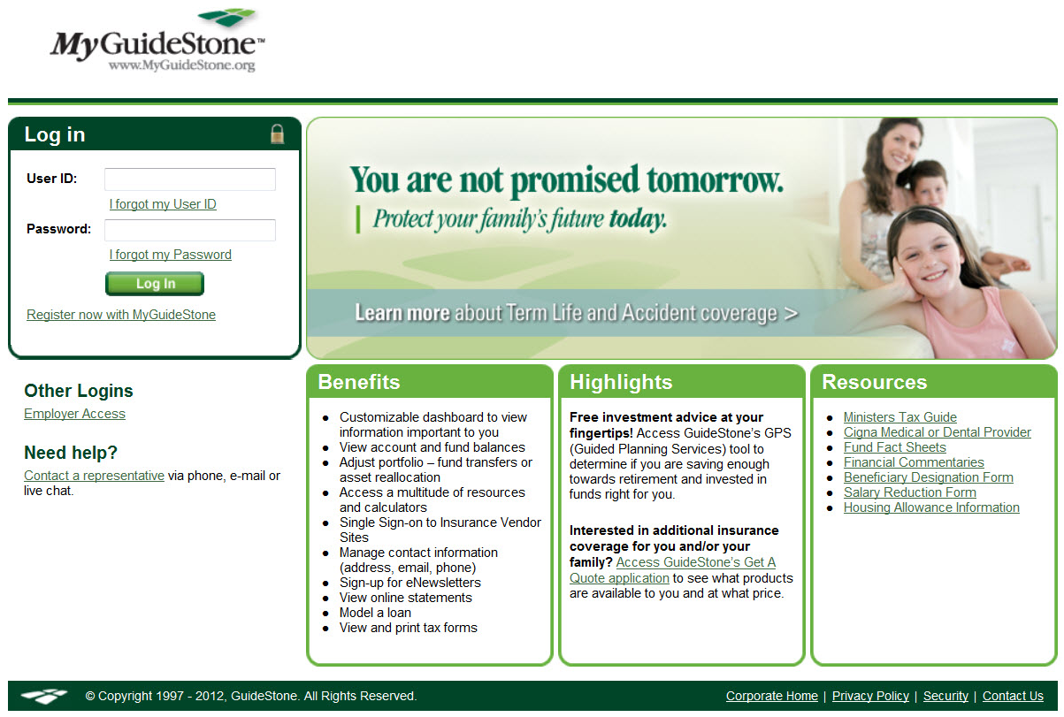
MyGuideStone.org
STAYING ON TRACK
B09-20
Notes:
To get connected, all you need to do is go to www.MyGuideStone.org and enter your user ID and password.
If you do not have a user ID, simply select the "Register Now" button to get connected in three simple steps.

Slide 22
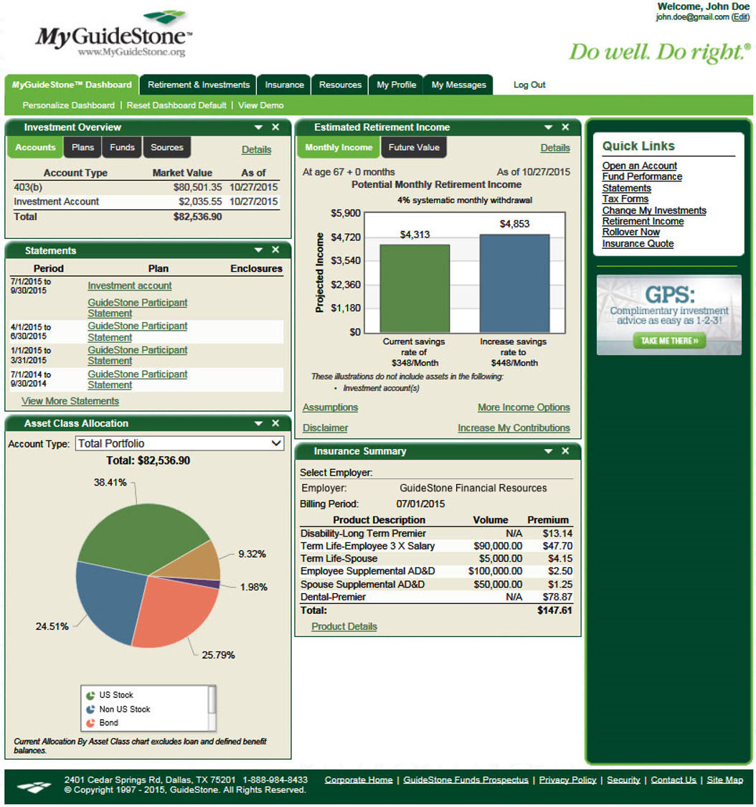
MyGuideStone Participant Online Access
STAYING ON TRACK
Personalized dashboard
Account information and transaction requests
User-friendly charts and graphs
Retirement planning tools
Retirement income gap analysis
Investment advice
Insurance planning tools
Ministry resources
B09-21
Notes:
Through MyGuideStone you will have 24–7 access to your own personalized account information.
(Discuss MyGuideStone features.)

Slide 23
Disconnected or Connected?
STAYING ON TRACK
Connected
You have established a user ID and password and regularly review your account
You review your Quarterly Account Statements
B09-22
Notes:
Once you are able to log into MyGuideStone, you then have access to look at your past account statements.

Slide 24
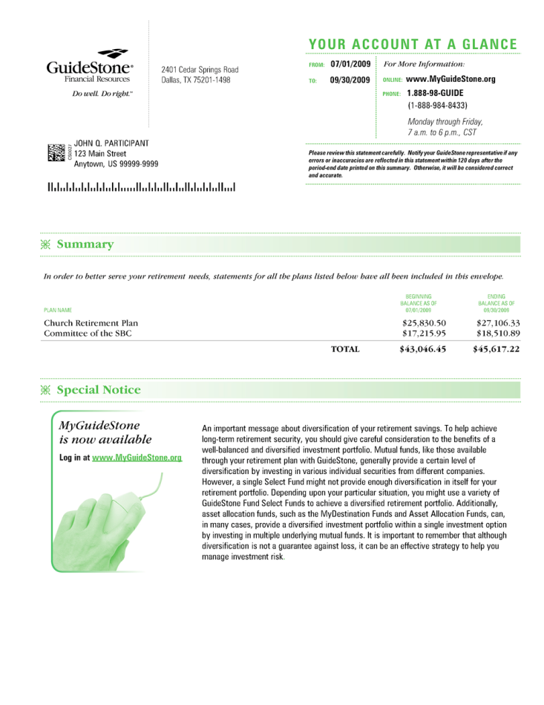
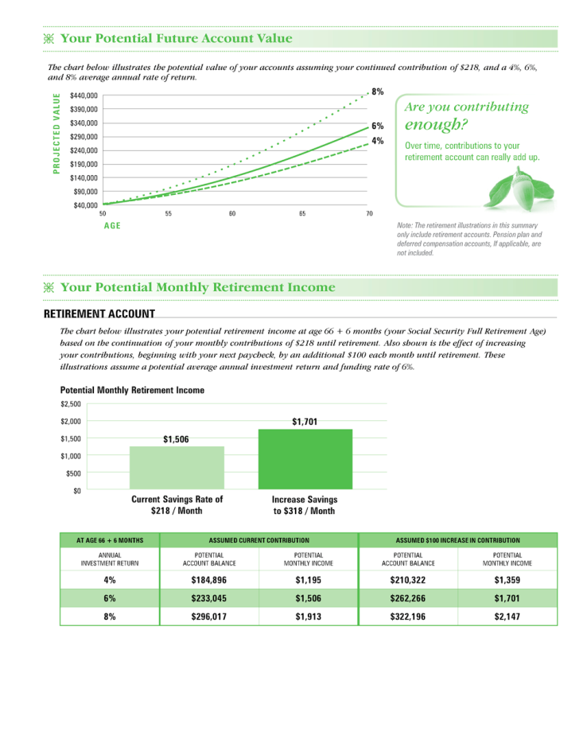
Reviewing Quarterly Account Statements
STAYING ON TRACK
Addresses important retirement planning questions:
What do I have?
What will it provide?
What should I do?
User-friendly charts and graphs
Includes projected account value and estimated monthly retirement income
Electronic delivery for faster service and improved security
B09-23
Notes:
(Discuss features of the Quarterly Account Statements.)

Slide 25
Disconnected or Connected?
STAYING ON TRACK
Connected
You have established a user ID and password and regularly review your account
You review your Quarterly Account Statements
You take advantage of planning tools and resources provided by GuideStone
B09-24
Notes:
And last but not least, Connected investors take advantage of the many helpful planning tools and resources available through GuideStone. This includes GuideStone’s GPS: Guided Planning Services®.

Slide 26
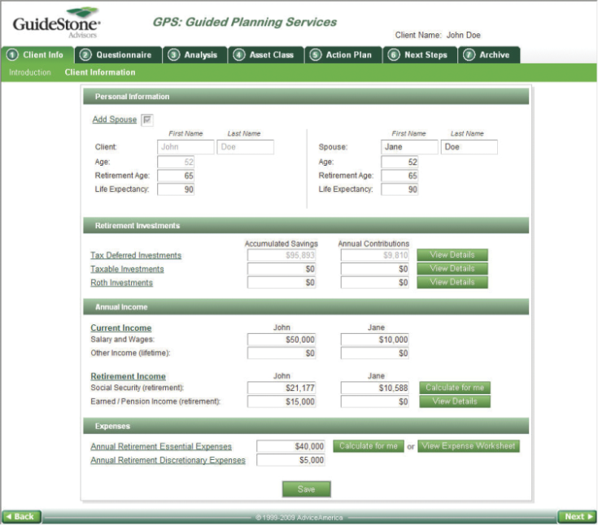
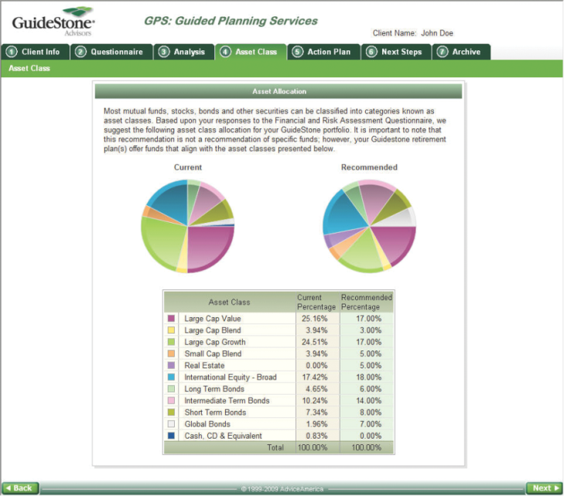
Guided Planning Services
STAYING ON TRACK
Personalized investment analysis and recommendations
Customized action plans to help set and reach retirement goals
Access online or by a phone appointment
Financial advice is provided by GuideStone Advisors, a controlled-affiliate of GuideStone Financial Resources.
B09-25
Notes:
Guided Planning Services is an online service built to help simplify retirement planning. This step-by-step tool is available now and offers several distinct advantages, including individualized feedback, long-term planning guidance, simplified navigation and detailed investment analysis. With this helpful tool, participants can get the guidance they need to help them reach their retirement goals. The service can be accessed anytime at www.MyGuideStone.org or by calling toll-free 1-888-98-GUIDE (1-888-984-8433).

Slide 27
What type of investor are you?
STAYING ON TRACK
Accidental
or
Intentional
Small Picture
or
Big Picture
Disconnected
or
Connected
B09-26
Notes:
So we come back to where we started. What type of investor have you been in the past? What type of investor do you need to work toward becoming as you move into the future?
The more you are described by the left side of the screen, probably the less likely you will be able to do all the things you have dreamed about doing in your retirement years.
If the right side of the screen better describes you, you are to be affirmed and commended because you are on the right track toward a successful and rewarding financial experience in retirement.
My final challenge to you today is to get you to realize that all of this is in your control. If you start early enough, even with modest resources, you have the information and tools available to you to help you be prepared.
As you consider the past and look to the future as an investor — be Intentional, look at the Big Picture and stay Connected — commit yourself to take on the personal responsibility for your own financial well-being.
And know that GuideStone will be there to assist you, throughout your life and ministry, as we work alongside you to help you enhance your financial security.

Slide 28
STAYING ON TRACK
The MyDestination Funds attempt to achieve their objectives by investing in the GuideStone Select Funds. These funds are managed to a retirement date (“target date”) by adjusting the percentage of fixed-income securities and equity securities to become more conservative each year until reaching the retirement year and then approximately 15 years thereafter. The target date in the name of the funds is the approximate date when an investor plans to start withdrawing money. By investing in them, you will also incur the expenses and risks of the underlying Select Funds. The principal risks of the Funds will change depending on the asset mix of the Select Funds in which they invest. You may directly invest in the Select Funds. The Funds’ value will go up and down in response to changes in the share prices of the investments that they own. There is no guarantee that the Funds’ principal value will increase, including at the targeted date. It is possible to lose money by investing in the Funds. The Asset Allocation Funds attempt to achieve their objectives by investing in the GuideStone Select Funds. By investing in these Funds, you will also incur the expenses and risks of the underlying Select Funds. The principal risks of the Funds will change depending on the asset mix of the Select Funds in which they invest. You may directly invest in the Select Funds. The Funds’ value will go up and down in response to changes in the share prices of the investments that they own. It is possible to lose money by investing in the Funds.
B09-27
Notes:
Mandatory Slide — Cannot Be Hidden

Slide 29
STAYING ON TRACK
You should carefully consider the investment objectives, risks, charges and expenses of the GuideStone Funds before investing. A prospectus with this and other information about the Funds may be obtained by calling 1-888-GS-FUNDS (1-888-473-8637) or downloading one at GuideStoneFunds.com. It should be read carefully before investing.
GuideStone Funds are distributed by Foreside Funds Distributors LLC, not an advisor affiliate.
B09-28
Notes:
Mandatory Slide — Cannot Be Hidden

Slide 30
STAYING ON TRACK
Please complete the Meeting Registration Form to let us know how we can better serve your needs.
B09-29

Slide 31
B09-30

Slide 32
Optional Slides
B09-31

Slide 33
Defining “Retirement”
STAYING ON TRACK
The day they stop paying you
B09-32
Notes:
We don’t define “retirement” as hoarding wealth for a life of leisure. We know that those who serve the Lord will continue that service even after the paychecks stop. So for today, let’s look at retirement simply as…the day they stop paying you.

Slide 34
Retirement Planning Myths
STAYING ON TRACK
I can always work longer
I should pay off my debt before I start saving
Some basic rules of thumb will work for me
Employer contributions alone will be enough
B09-33
Notes:
You may not be able to work as long as you intend. EBRI survey: 49% of workers have to retire earlier than planned.
Paying off debt is good, but a credit card statement with a zero balance won’t feed you.
Some rules of thumb can be good starting places. For example, contribute 10–15% of your pay and shoot for having 8–12 times your salary to draw from. But every situation is different.
Employer contributions are great, but they won’t be enough for most people.

Slide 35
Make a Plan
STAYING ON TRACK
Determine how much you will need
Determine what it will take to get there
Put a plan in motion
B09-34
Notes:
Later, we’ll talk about tools you can use.
Will Rogers: “Even if you are on the right track, you’ll get run over if you just sit there.”

Slide 36
Put Your Money to Work as Early as Possible
STAYING ON TRACK
You may delay, but time will not.
— Benjamin Franklin
B09-35

Slide 37
Plan Ahead for Painless Opportunities
STAYING ON TRACK
Increase contributions when:
You get a raise
You pay off a debt
You lower the cost of something
You receive other sources of income
B09-36
Notes:
Examples of lowering costs:
Finishing college financing
Refinancing a loan
Trading in a gas-guzzling vehicle
Sit down with your spouse. Think ahead about upcoming opportunities and dedicate them to retirement contributions.

Slide 38
Take Full Advantage of Your Employer’s Plan
STAYING ON TRACK
Matching
Convenience
Consistent contributions
B09-37

Slide 39
Rollover Contributions
STAYING ON TRACK
You’ll make better decisions when you understand what you really have.
Overall asset allocation
Total investment balance
B09-38

Slide 40
Easy Steps to Take Now
STAYING ON TRACK
Increase now — adjust later
Salary Reduction Agreement
Plan ahead for painless opportunities
Consider rolling in old plans
Make a plan — GuideStone can help
B09-39

